Slide 1
Distributive Property
With pictures!

Slide 2
(
)

Slide 3
(
)

Slide 4
(
)

Slide 5
(
)
$$ab^{2}$$
$$cd$$

Slide 6
$$=4x$$
(
)
$$ab^{2}$$
$$cd$$

Slide 7
$$=4x$$
(
)
$$4x$$
$$ab^{2}$$
$$cd$$

Slide 8
$$=4x$$
(
)
$$4x$$
$$ab^{2}$$
$$cd$$
$$4xab^{2}$$

Slide 9
$$=4x$$
(
)
$$4x$$
$$ab^{2}$$
$$cd$$
$$4xab^{2}$$
$$4xcd$$

Slide 10
(
)
$$ab^{2}$$
$$cd$$

Slide 11
$$=(x+4)$$
(
)
$$ab^{2}$$
$$cd$$

Slide 12
$$=(x+4)$$
(
)
$$(x+4)$$
$$ab^{2}$$
$$cd$$

Slide 13
$$=(x+4)$$
(
)
$$(x+4)$$
$$ab^{2}$$
$$cd$$
$$(x+4)ab^{2}$$

Slide 14
$$=(x+4)$$
(
)
$$(x+4)$$
$$ab^{2}$$
$$cd$$
$$(x+4)ab^{2}$$
$$\left(x+4\right)cd$$

Slide 15
$$=(x+4)$$
(
)
$$(x+4)$$
$$ab^{2}$$
$$cd$$
$$(x+4)ab^{2}$$
$$\left(x+4\right)cd$$

Slide 16
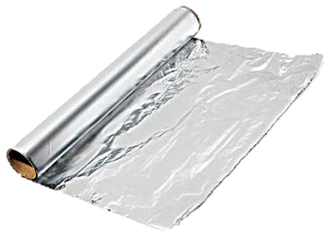
$$=(x+4)$$
(
)
$$(x+4)$$
$$ab^{2}$$
$$cd$$
FOIL
$$(x+4)ab^{2}$$
$$\left(x+4\right)cd$$
DOUBLE
DISTRIBUTION
$$=xab^{2}+4ab^{2}$$
$$xcd+4cd$$

